Slide 1
Mathematics (9-1) - iGCSE
2018-20
Year 09
Unit 14 – Answers

Slide 2
14 - Prior knowledge check
Page 679
a. 5% b. 112 c. 50
5:25
81
a. Continuous b. Discrete c. Categorical d. Continuous e. Discrete

Slide 3
14 - Prior knowledge check
Page 679
a. Mean = 5.4; median = 6; range - 7; mode = 4
Mean = 6.5; median = 6; range = 5; mode = 6
Mean = 3.0125; median = 2.65; range = 1.8; mode = 3.8
Mean = 5.375; median = 5; range = 5; mode = 3
a. 10 < m ≤ 11 b. 10.75 c. 10 < m ≤ 11
a. 10 b. 7 c. 7

Slide 4
14.1 - Sampling
Page 679
a. 620 b. g c. 19.4% d. 13
a. No; it is biased to people who shop in the supermarket,
Yes; each person is equally likely to be selected.
a. Yes, limited time frame.
Yes, biased to people who do recycle,
Yes, not everyone is equally likely.
Not biased, but a very small sample.

Slide 5
14.1 - Sampling
Page 679
a. 13, A8,09, 32,02, 31, 50
86,13,60, 78,48, 80
46,12, 48, 06, 24, 14, 37, 39
a. 100
List the members alphabetically. Generate 100 random numbers between 1 and 1000.
$\frac{1}{8}$ d. $\frac{1}{12}$

Slide 6
14.1 - Sampling
Page 680
a. Total number of students = 1000. $\frac{100}{1000}$ = $\frac{1}{10}$ = 10%
21, 19, 18, 20, 21
21 + 19 + 18 + 20 + 21 = 100
a. There are different proportions of male and female in the club. b. 35 women, 45 men c. 21 women, 27 men
7, 19, 15, 29
a. $\frac{1}{8}$ b. 320
2

Slide 7
14.2 – Cumulative Frequency
Page 680
a. 21 b. i. 15 ii. 26
Mass, m (kg) | Cumulative Frequency
3 < m ≤ 4 | 4
3 < m ≤ 5 | 16
3 < m ≤ 6 | 33
3 < m ≤ 7 | 43
3 < m ≤ 8 | 50

Slide 8
14.2 – Cumulative Frequency
Page 680
Height, h (m) | Cumulative Frequency
4 < h ≤ 4.2 | 2
4 < h ≤ 4.4 | 5
4 < h ≤ 4.6 | 10
4 < h ≤ 4.8 | 18
4 < h ≤ 5.0 | 30
4 < h ≤ 5.2 | 48
4 < h ≤ 5.4 | 63
4 < h ≤ 5.6 | 70

Slide 9
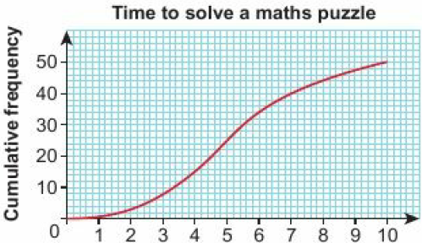
14.2 – Cumulative Frequency
Page 680
a. b. 5 c. 10

Slide 10
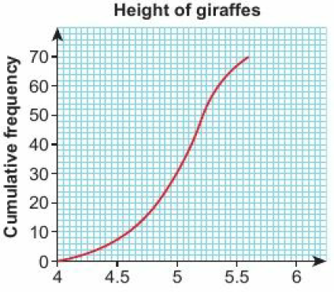
14.2 – Cumulative Frequency
Page 680
a. b. 5.06m

Slide 11
14.2 – Cumulative Frequency
Page 680
a. b. 54 c. 50 d. 58 e. 8

Slide 12
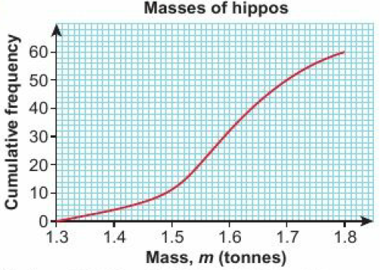
14.2 – Cumulative Frequency
Page 680
a.
Median = 1.59, LQ = 1.52, UQ = 1.67, IQR = 0.15
22 d. 1.64

Slide 13
14.2 – Cumulative Frequency
Page 680
a.
Time, t (seconds) | Cumulative Frequency
0 < t ≤ 10 | 16
10 < t ≤ 20 | 50
10 < t ≤ 30 | 82
30 < t ≤ 40 | 96
40 < t ≤ 50 | 100

Slide 14
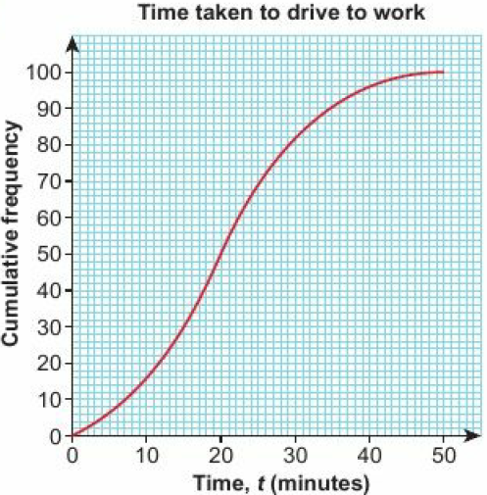
14.2 – Cumulative Frequency
Page 680
b.
20 minutes d. 55 days

Slide 15
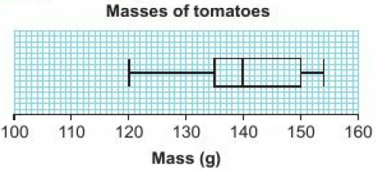
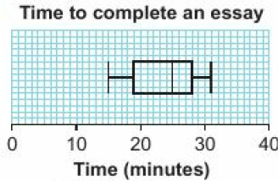
14.3 – Box Plots
Page 681
a. 25.5 b. 38
a. 25 b. LQ=19,UQ = 28 c.

Slide 16
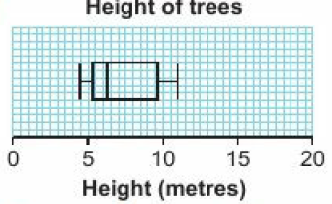
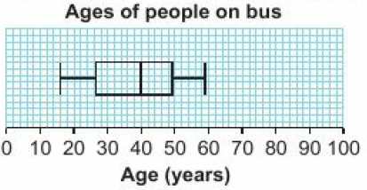
14.3 – Box Plots
Page 681
a. 16 b. 40 c. LQ = 26.5, UQ = 49.5 d. 23 e.

Slide 17
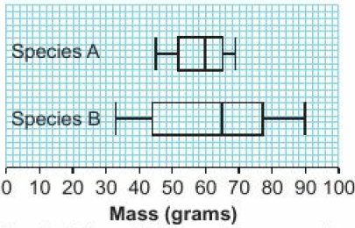
14.3 – Box Plots
Page 681
a. Club A b. Club A: 6; Club B: 3 c. Club A: 12; Club B: 8
a. Masses of different species of bird b. Species B has a higher median mass and a greater spread of masses.

Slide 18
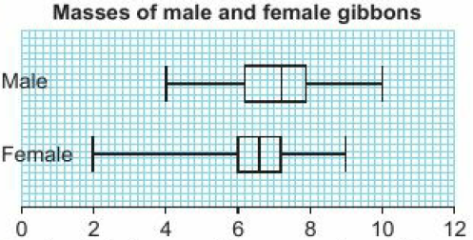
14.3 – Box Plots
Page 681
a. Medians: 6.6 female, 7.2 male LQs: 6 female, 6.2 male UQs: 7.2 female, 7.9 male
Masses of male and female gibbons
Females had a lower median mass and a smaller spread of masses.

Slide 19
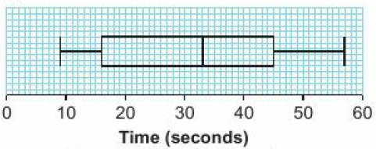
14.3 – Box Plots
Page 681
a. 33 b.
Boys took loner on average and had a greater spread of times.

Slide 20
14.4 – Drawing Histograms
Page 681
a.
14 < m ≤ 16
15.14

Slide 21
14.4 – Drawing Histograms
Page 681
a. 5, 10, 10 b. 2.4, 3.5, 1.5
5.5, 11.5, 15.5, 10, 8

Slide 22
14.4 – Drawing Histograms
Page 681

Slide 23
14.4 – Drawing Histograms
Page 682
a. 27.3 b.

Slide 24
14.5 – Interpreting Histograms
Page 682
a. 119.875 b. 120 < m ≤ 130
a. 15 b. 100 c. 135
a. 40 b. 230 c. 94

Slide 25
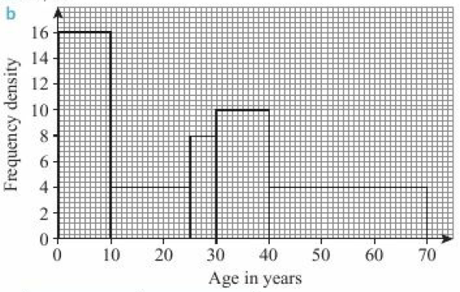
14.5 – Interpreting Histograms
Page 682
a. 60, 40 b.

Slide 26
14.5 – Interpreting Histograms
Page 682
a. b. 19.77 mins c. 30
240.5th value = 20.5th value in the 25 < x ≤ 30 class. $\frac{20.5}{80}$ = 1.28 so median = 26.28
Time | Frequency
15 < t ≤ 16 | 6
16 < t ≤ 18 | 14
18 < t ≤ 20 | 20
20 < t ≤ 25 | 15
25 < t ≤ 30 | 5

Slide 27
14.5 – Interpreting Histograms
Page 682
a. 100 b. 85 c. 1.51 d. e. 1.524 f. 36
a. 46 b. 23.5th = 4.9375 c. 15
Time | Frequency
1.4 < m ≤ 1.45 | 5
1.45 < m ≤ 1.48 | 15
1.48 < m ≤ 1.5 | 20
1.5 < m ≤ 1.55 | 20
1.55 < m ≤ 1.6 | 15
1.6 < m ≤ 1.7 | 10

Slide 28
14.6 – Comparing Distributions
Page 682
a. mean = 1.38, median = 1.4, mode = 1.5, range = 0.3
mean = 4.9, median = 4.5, mode = 3, range = 5
a. 294.1, 267.33 b. 30, 14
Males weigh on average more and have a larger spread of masses.

Slide 29
14.6 – Comparing Distributions
Page 682
a. b. African elephants are on average taller and have a greater spread of heights
a. 23.55 b. 18 c. 85,8
a. Median and IQR (unaffected by extreme values: 120 in males, for example)
Males completed the race quicker on average (medians are 78 and 84.5) and had a smaller spread (IQRs are 8 and 14)

Slide 30
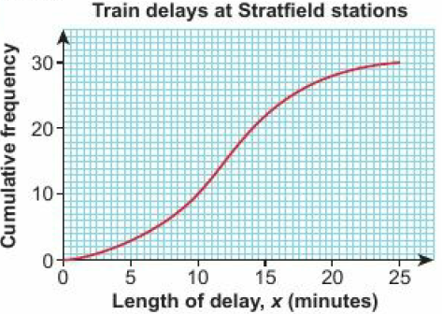
14.6 – Comparing Distributions
Page 682
a.
median = 12, IQR = 6.8
On average the delays at Westford were longer and had a larger spread

Slide 31
14.6 – Comparing Distributions
Page 682
Checkpoint B higher average (median 38 compared to 32) and same spread (IQR 11 compared to 11)
Females had a higher average age and a larger spread
Women had a higher average but a lower spread

Slide 32
14 – Check Up
Page 682
a. 16, 18, 14, 17, 15 b. 112, 283, 185, 191, 255
a.
Mass, m (kg) | Cumulative Frequency
20 < m ≤ 23 | 1
23 < m ≤ 26 | 5
26 < m ≤ 29 | 13
28 < m ≤ 32 | 34
32 < m ≤ 35 | 66
35 < m ≤ 38 | 84
38 < m ≤ 41 | 90

Slide 33
14 – Check Up
Page 682
b.
3.3kg
LQ = 30.5kg, UQ = 35.2kg, IQR = 4.7kg
i. 74 ii. 71

Slide 34
14 – Check Up
Page 683
a.
36

Slide 35
14 – Check Up
Page 683
Girls have a higher average time and a bigger spread of times.
a. 28 b. 22
First party had a higher average age and a greater spread of ages
56

Slide 36
14 – Strengthen
Page 683
Sampling
a. B b. i. 15 ii. 8 c. 23 d. Equal
a. 120 b. 20% c. 3.2%, 5.6%. 6.4%, 4.8%, 4%

Slide 37
14 – Strengthen
Page 683
a. 02, 79, 21, 51, 21, 08, 01, 57, 01, 87, 33, 73, 17, 70, 18, 40, 21, 24, 20, 66, 62
02, 21, 21, 08, 01, 01, 17, 18, 21, 24, 20
02, 21, 08, 01, 17, 18, 24, 20
02, 21, 08, 01, 17
02, 21, 51, 08, 01, 57, 33, 17
027, 108, 015, 018, 124

Slide 38
14 – Strengthen
Page 683
Graphs and Charts
a.
Mass, m (kg) | Cumulative Frequency
70 < m ≤ 75 | 1
75 < m ≤ 80 | 9
80 < m ≤ 85 | 28
85 < m ≤ 90 | 43
90 < m ≤ 95 | 53
95 < m ≤ 100 | 60

Slide 39
14 – Strengthen
Page 683
Graphs and Charts
b.

Slide 40
14 – Strengthen
Page 683
a. median = £4.40, LQ = £3.50, UQ = £5.10 b. £1.60
a. 60 b. 30 c. 45cm d. LQ = 35cm, UQ = 54cm e. 19cm

Slide 41
14 – Strengthen
Page 683
a.
Time, t (mins) | Cumulative Frequency
65 < t ≤ 68 | 4
68 < t ≤ 71 | 11
71 < t ≤ 74 | 28
74 < t ≤ 77 | 41
77 < t ≤ 80 | 50

Slide 42
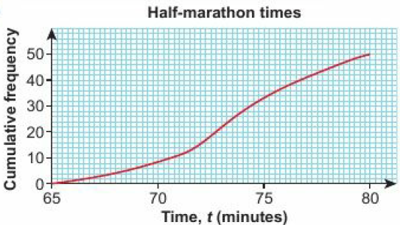
14 – Strengthen
Page 683
b. c. Median = 73.4mins, LQ – 71.3mins, UQ – 76.2mins. d. 16 e. 34

Slide 43
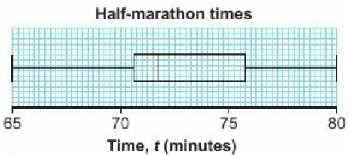
14 – Strengthen
Page 683

Slide 44
14 – Strengthen
Page 683
a. i. 5 ii. 1.6 b.
Length, l (mm) | Frequency | Class Width | Frequency density
10 < t ≤ 15 | 2 | 15 – 10 = 5 | 2 ÷ 5 = 0.4
15 < t ≤ 20 | 8 | 20 - 15 = 5 | 8 ÷ 5 = 1.6
20 < t ≤ 30 | 15 | 30 – 20 = 10 | 15 ÷ 10 = 1.5
30 < t ≤ 40 | 12 | 40 – 30 = 19 | 12 ÷ 10 = 1.2
40 < t ≤ 60 | 5 | 60 – 40 = 20 | 5 ÷ 20 = 0.25

Slide 45
14 – Strengthen
Page 683
c.
a. 6 b. 9 c. 6 d. 19

Slide 46
14 – Strengthen
Page 683
Comparing Data
a. b. i. higher ii. Boys, Girls
a. 23 b. 6,12,18 c. 59 kg, 67 kg, 75 kg d. 67 kg e. 16kg
 | Lower Quartile | Median | Upper Quartile | Interquartile Range
Male | 4 | 6 | 7 | 3
Female | 3 | 5 | 8 | 5

Slide 47
14 – Strengthen
Page 684
a. 69 kg
LQ = 63 kg, UQ = 78.5 kg
15.5 kg
Female wild boars have a smaller mass on average and a higher spread of masses.

Slide 48
14 – Extend
Page 684
a. b. i. 37mph ii. 10mph
75 and 45

Slide 49
14 – Extend
Page 684
Stratified: $\frac{1}{20}$ of each group - cranes: 22.5 (so 23 or 22), forklift: 31, dump: 6.5 (so 6 or 7)
Stratified: 25% - male: 30 builders, 10 electricians, 5 plumbers; Female: 17.5 (so 18) builders, 9 electricians, 8.5 (so 8) plumbers

Slide 50
14 – Extend
Page 684
a. Number of clients with: rabbits = 16, guinea pigs = 18, hamsters = 9, gerbils = 7
Numbered alphabetical list and random number generation
a. 4 b. 4 minutes and 9.6 minutes
a. Less variation in temperatures b. Higher average temperature

Slide 51
14 – Extend
Page 684
a. Discrete b.
Peas | Cumulative Frequency
≤ 3 | 7
≤ 4 | 18
≤ 5 | 36
≤ 6 | 70
≤ 7 | 90
≤ 8 | 100

Slide 52
14 – Extend
Page 684
c, d, e.
Discrete data; no such thing as 4.5 peas
6

Slide 53
14 – Extend
Page 684
a. b.
5
2
Rabbits | Cumulative Frequency
2 | 8
3 | 23
4 | 46
5 | 87
6 | 112
7 | 120

Slide 54
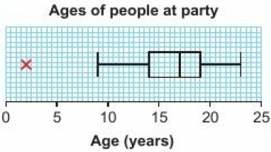
14 – Extend
Page 684
a. 14.9 b. LQ = 14.3, UQ = 15.5 IQR = 1.2 c. 1.8 d. 28.6
a. 4 b. 8 – 24 c. 2 d.

Slide 55
14 – Extend
Page 684
a. b. 23

Slide 56
14 – Extend
Page 685
a. b. 707.5kg c. 747kg d. 700 < m ≤ 750 e. 53 f. 760kg – 770kg

Slide 57
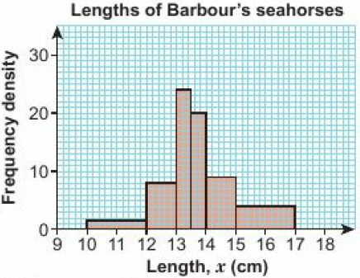
14 – Extend
Page 685
a. b. 13.76cm c. 13.6cm d. 13.4cm

Slide 58
14 – Unit Test
Page 685
Sample student answer
A ruler has been used making it neater and more accurate to read off the values. The group B lines have been drawn differently to group A to distinguish them on the graph and make it less likely to read off the wrong values.
The lower quartile value is wrong because the scale has been read incorrectly. The student has tried to read '25' but has just counted up 5 squares, which really is 30.

